Slide 1
SIGN LANGUAGE DETECTION USING ML
TEAM NAME:-
HAYDEN PAUL. R [110720243019]
ISAAC SOLOMON. D [110720243020]
DHARUNESHAN. S [110720243011]
GUIDANCE:-
MRS. VANISHREE [Asst. PROF]
DEPT NAME:- B.TECH AI&DS
SEMESTER:- VI

Slide 2
ABSTRACT:-
The abstract for sign language to text detection using Python describes a computer vision technology that can recognize and translate sign language gestures into written text using the Python programming language.
The system uses a combination of machine learning algorithms and natural language processing algorithms to detect and classify different sign language gestures.
It is designed to be highly accurate and can handle different sign language dialects and variations.
This technology has the potential to improve communication and accessibility for deaf or hard-of-hearing individuals in various settings.

Slide 3
OBJECTIVE:-
Developing an accurate and reliable machine learning model to detect and classify different sign language gestures based on video data input.
Implementing natural language processing algorithms to convert the recognized signs into written text in real-time.
Integrating the technology with a user-friendly interface to make it accessible and easy to use for individuals with varying levels of technical expertise.
Evaluating the performance of the system using standard evaluation metrics to ensure high accuracy and reliability.
Testing the system with different sign language dialects and variations to ensure its robustness and adaptability to different settings and contexts.

Slide 4
LITERATURE SURVEY:-
"Real-time American Sign Language Recognition Using Deep Learning Models" by S. Sharma and S. Bharti. This paper proposes a real-time sign language recognition system that uses a combination of CNN and long short-term memory (LSTM) networks to classify hand gestures. The system achieved high accuracy and was implemented in Python using TensorFlow and Keras libraries.
"A Comparative Study of Sign Language Recognition using Neural Networks" by N. V. Soumya and V. V. Krishna. This paper presents a comparative study of various neural network architectures, such as CNN, RNN, and deep belief networks (DBN), for sign language recognition. The study evaluated the performance of these models using the American Sign Language dataset and implemented the models using Python and the TensorFlow library.
"A Real-time System for Recognition of American Sign Language Gestures Using Python" by J. E. Guerrero, M. A. Roa, and J. A. Cruz-Ledesma. This paper presents a real-time sign language recognition system that uses skin color detection and contour analysis to segment hand regions and a support vector machine (SVM) classifier to recognize the gestures. The system achieved high accuracy and was implemented in Python using OpenCV and scikit-learn libraries.

Slide 5
EXISTING METHODOLOGY:-
Convolutional Neural Networks (CNN) are a widely used deep learning architecture for image recognition and classification.
Recurrent Neural Networks (RNN) are used to analyze sequences of data, making them suitable for recognizing sign language gestures that involve motion.
Region-Based Convolutional Neural Networks (R-CNN) are a variant of CNNs that can localize objects within an image.
Support Vector Machines (SVM) are a machine learning algorithm that can be used for classification tasks.
OpenCV and scikit-learn libraries provide various tools for image and video processing, including color detection, contour analysis, and machine learning algorithms. These libraries can be used to implement sign language recognition systems in Python.

Slide 6
BLOCK DIAGRAM:-
DATABASE
CREATION
IMAGE
PREPROCESSING
HAND
EXTRACTIONS
SHAPE(RT)
+
TEXTURE(GF)
+
PCA
FEATURE EXTRACTION & OPTIMIZATION
SIGNS INTO TEXT
CLASSIFICATIONS

Slide 7
PROPOSED METHODOLOGY:-
Collect a large dataset of sign language videos with corresponding text labels. Preprocess the video data by extracting frames and resizing them to a standard size.
Use a pre-trained hand detection model, such as Haar Cascades or YOLO, to detect and track hand regions in the video frames. Extract features from the hand regions, such as histogram of oriented gradients (HOG) or local binary patterns (LBP).
Train a deep learning model, such as CNN or LSTM, to classify the sign language gestures based on the extracted features. Use NLP techniques, such as tokenization, stemming, and part-of-speech tagging, to convert the recognized sign language gestures into written text.
Develop a user-friendly interface that allows users to input video data and receive the corresponding text output in real-time. Evaluate the performance of the system using standard evaluation metrics, such as accuracy, precision

Slide 8
BLOCK DIAGRAM:-
USER
GESTURES
CAMERA
EXTRACT HAND
HISTOGRAM
PREDICTED LABEL
OPEN CV
CNN + PYAUDIO
TRANSFORM TO FRAMES
FRAMES
PREDICTING GUESTURE

Slide 9
COMPARISON:-
Similarities:
Differences:
Both methodologies involve data preprocessing, feature extraction, and model training using machine learning and deep learning algorithms.
Both methodologies aim to recognize sign language gestures and translate them into written text using NLP techniques.
Both methodologies require a user interface for input and output.
The proposed methodology includes hand detection and tracking as a separate step, while the existing methodology may use skin color detection and contour analysis to extract hand regions without hand detection.
The proposed methodology emphasizes the use of deep learning models, such as CNN and LSTM, for classification, while the existing methodology may also use SVM and R-CNN models.
The proposed methodology explicitly includes NLP techniques for text conversion, while the existing methodology may use template matching or pattern recognition for gesture recognition.

Slide 10
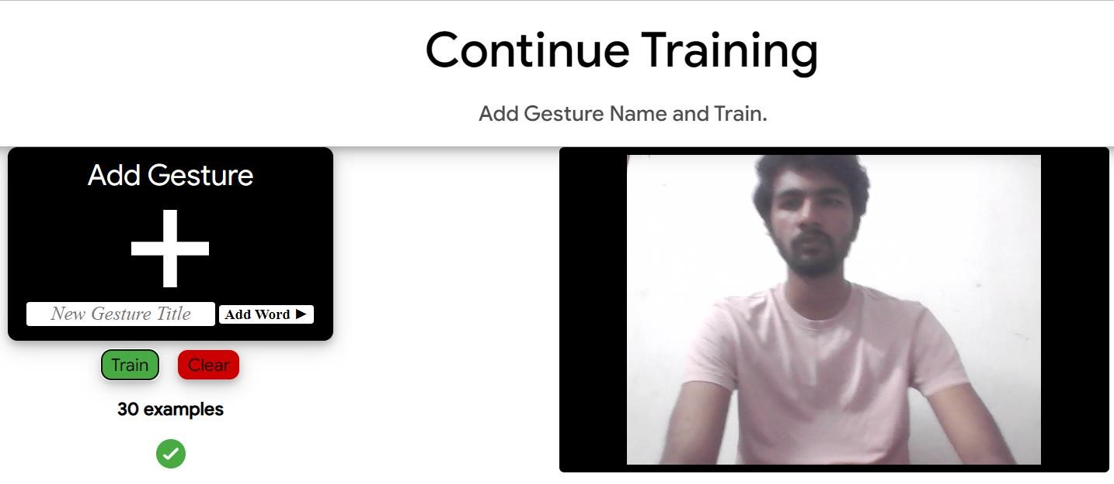
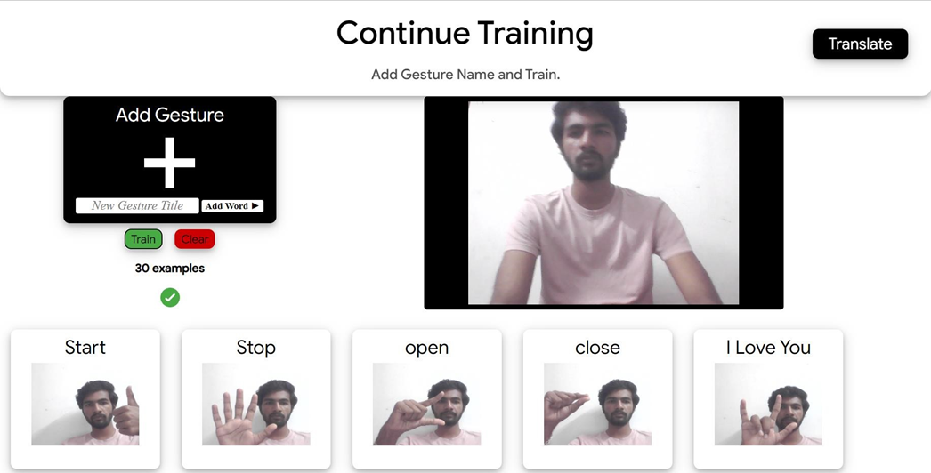
WORKING MODEL LIVE DEMO:- TRAINING:

Slide 11
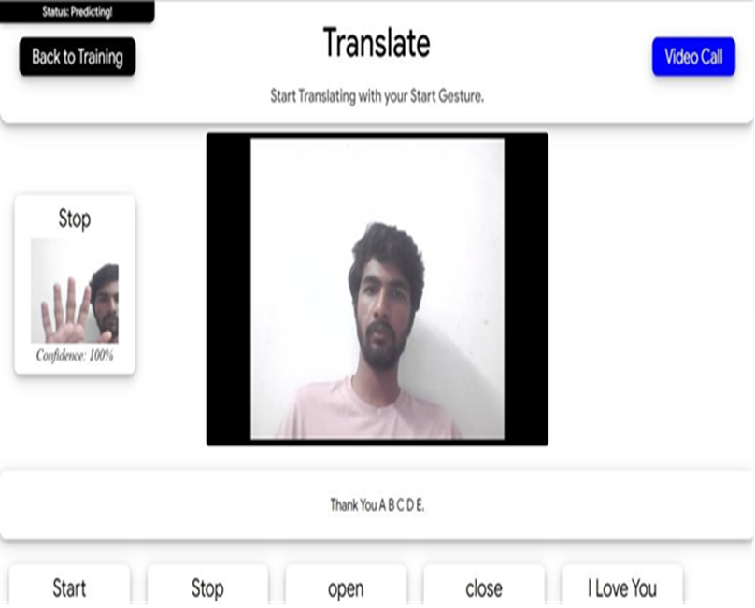
TESTING:-

Slide 12
ADVANTAGES:-
Large community and development
Open-source Libraries
Versatile and flexible
Easy to learn
Real-time processing

Slide 13
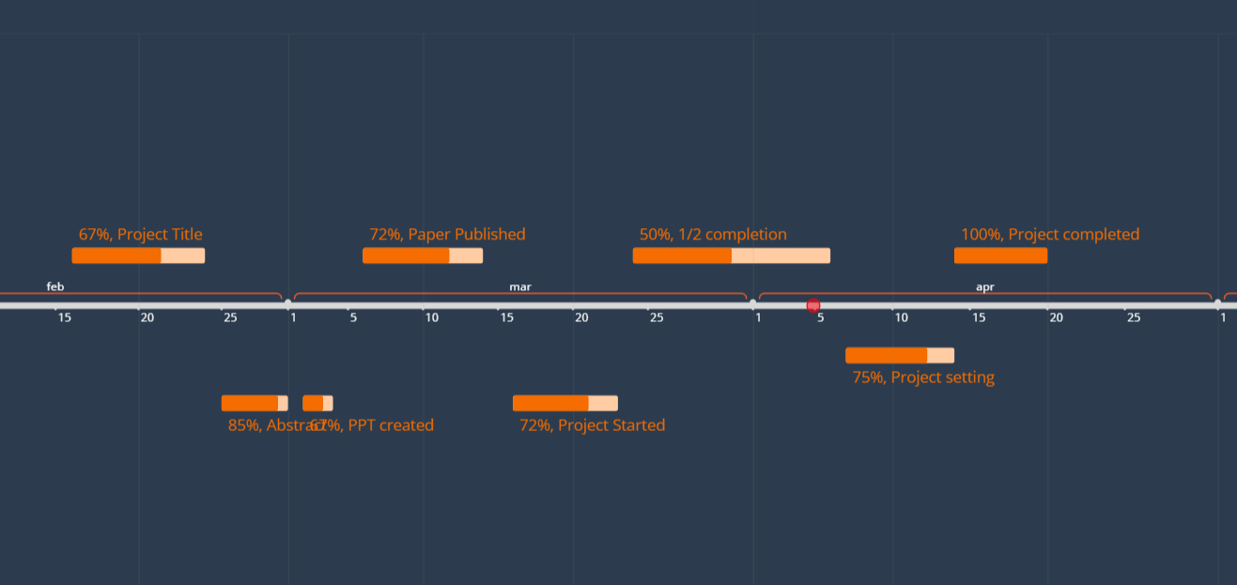
TIMELINE CHART OF WORK COMPLETION:-

Slide 14
REFERENCES:-
Swapnil Athavale and Mona Deshmukh. Dynamic hand gesture recognition for human computer interaction; a comparative study. International Journal of Engineering Research and General Science, 2(2):38–55, 2014.
GRS Murthy and RS Jadon. A review of vision based hand gestures recognition. International Journal of Information Technology and Knowledge Management, 2(2):405–410, 2009.
Ruchi Manish Gurav and Premanand K Kadbe. Real time finger tracking and contour detection for gesture recognition using opencv. In 2015 International Conference on Industrial Instrumentation and Control (ICIC), pages 974–977. IEEE, 2015.
Anupam Agrawal, Rohit Raj, and Shubha Porwal. Vision-based multimodal human-computer interaction using hand and head gestures. In 2013 IEEE Conference on Information & Communication Technologies, pages 1288–1292. IEEE, 2013.
Vinayak S Kunder, Aakash A Bhardwaj, and Vipul D Tank. Sign language recognition system with speech output. [6] Malavika Suresh, Avigyan Sinha, and RP Aneesh. Real-time hand gesture recognition using deep learning. International Journal of Innovations and Implementations in Engineering, 1, 2019.

